Slide 1
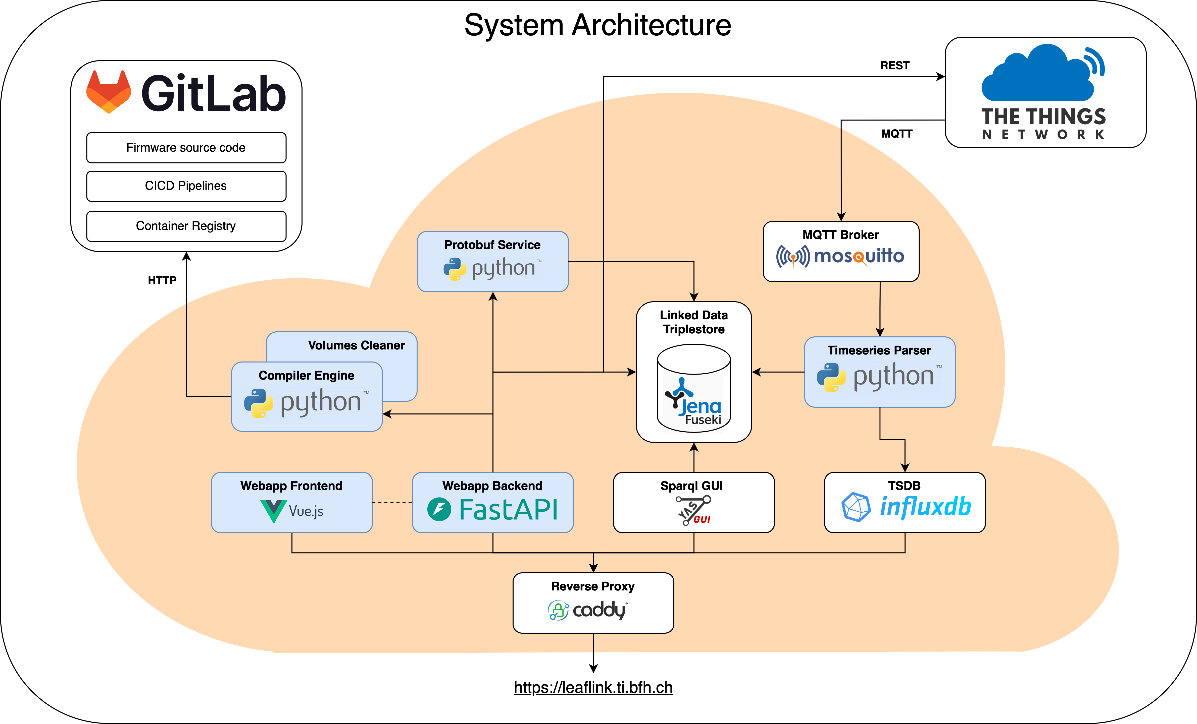
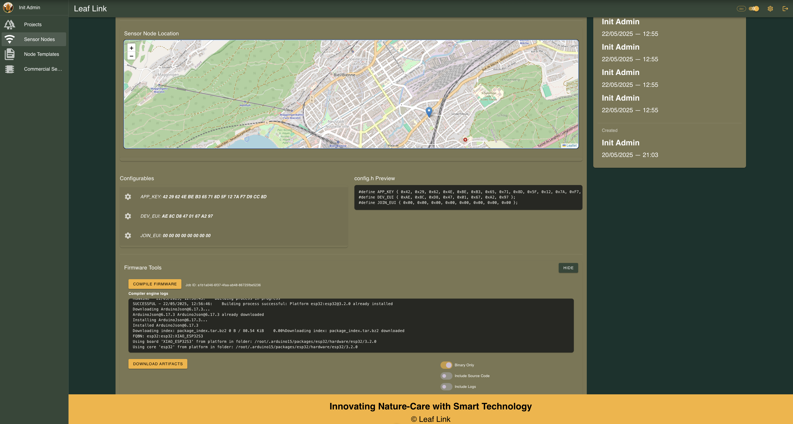
The Idea
This thesis addresses two core challenges in IoT systems design:
Organizing metadata and timeseries in a structured, extendable way.
Streamlining sensor nodes provisioning and lifecycle management.
The System
The Solution
The final product provides several convenience features to the user to increase efficiency and reduce manual errors:
Flashing of custom-built firmware with auto-injected configuration (e.g., TTN keys) directly from the Web UI.
Automatic provisioning of devices on TTN, including key generation and assignment.
Centralized management of metadata like projects and sensor nodes via an intuitive UI and possibility to link external resources.
The system offers a generic software solution that can be tailored to the specific needs of each project. All data is stored in a linked data triplestore which enables flexible, extendable data models.
Additionally, an integrated compiler engine automatically retrieves source code from a GitLab repository, compiles it, and makes the resulting binaries available to the frontend, significantly simplifying deployment workflows.
These challenges are reflected in existing research projects at the BFH. The study is based on the «Internet of Soils» project by the AHB department of the BFH and tries to find a solution to the issues outlined above.
In this context, environmental data is collected, transmitted via LoRaWAN (TTN) and persisted in a time-series database. The system currently relies on manual device management and fragmented data storage.
Blue = custom-built, white = hosted third-party tools.
The system is composed of multiple microservices, designed according to cloud-native principles. It is hosted on a virtual server provided by the BFH. A reverse proxy, positioned at the edge of the architecture, acts as a gatekeeper, exposing all public services through a single, SSL-secured entry point.
All custom Docker images are built and published via GitLab CI pipelines. As a result, the entire system can be deployed on any Docker-enabled server infrastructure using a single docker compose up command.
The system also integrates with the TTN ecosystem in two ways: first, through a REST API for device provisioning, and second, by receiving time series data over MQTT, which is forwarded to a local broker for further processing and storage.
From Soil to Screen: Data Flow in the System Architecture
This thesis focuses on the conception and development of a custom cloud infrastructure, symbolised by the orange component in the diagram above.
Management of a sensor node over the Web-UI
«LeafLink» Infrastructure for Sensor Management
Graduates: | Linus Degen Enrico Cirignaco
Supervisor: | Pascal Mainini
Expert: | Thomas Jäggi
Bachelor Thesis 2025 Degree Programme Computer Science

